Slide 1
AUTOMATED CROP SAVING SYSTEM
PRIYA J -2018115078
RAJASHREE S -2018115085
KEERTHNA AJ -2018115048

Slide 2
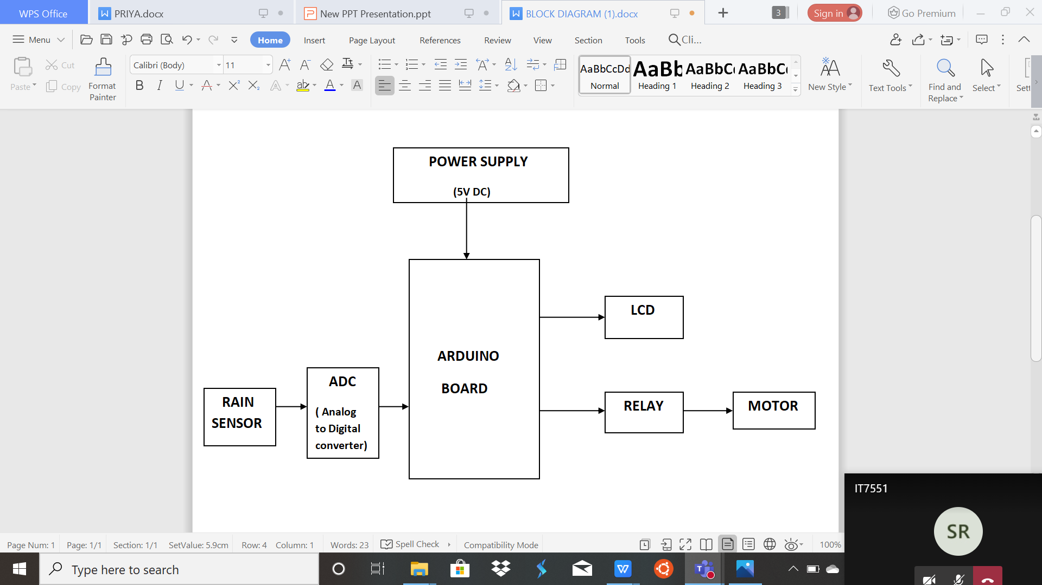
BLOCK DIAGRAM

Slide 3
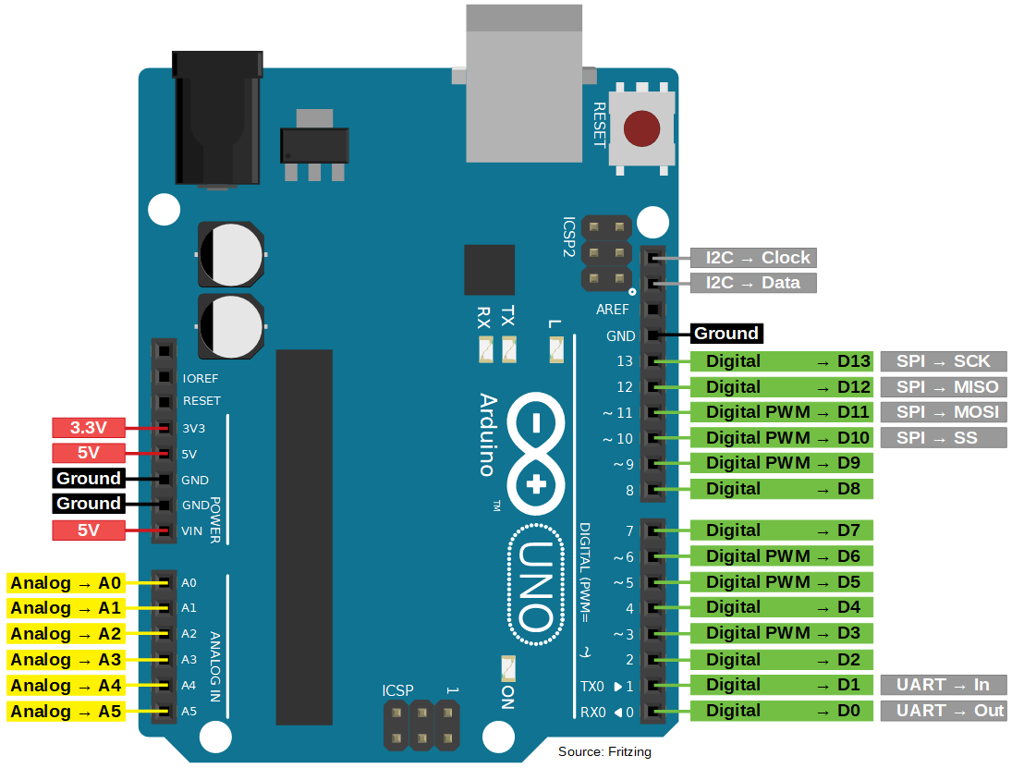
ARDUINO BOARD
BARREL JACK
VOLATGE REGULATOR( MAINTAINS THE VOLTAGE)
MAIN MICROCONTROLLER
DIGITAL PINS
(LCD IS CONNECTED TO THIS)
ANALOG PINS ( READS SIGNAL FROM THE ANALOG SENSOR AND CONVERT IT INTO DIGITAL VALUE )

Slide 4
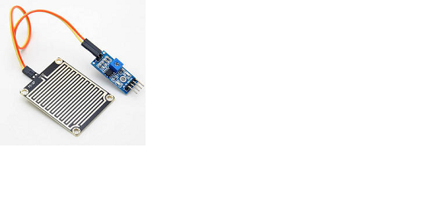
RAIN SENSOR AND ADC
SENSOR OUTPUT PINS
THIS PART IS CONNECTED TO THE ARDUINO BOARD
NAME 1.VCC 2.GND 3.A0 | FUNCTION Connects supply voltage- 5V Connected to ground Analog pin to get analog output
SENSING PAD WHERE THE RAIN DROP FALLS

Slide 5
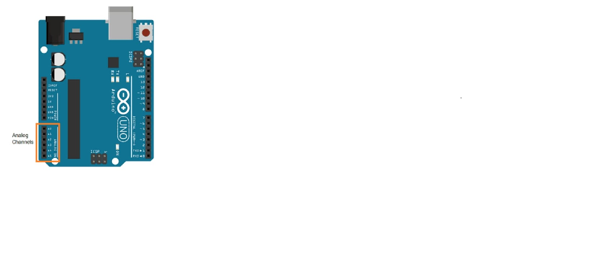
CONNECTION OF ADC WITH ARDUINO
THE 5V,GND AND A0 ARE CONNECTED WITH THE ANALOG DIGITAL CONVERTER

Slide 6
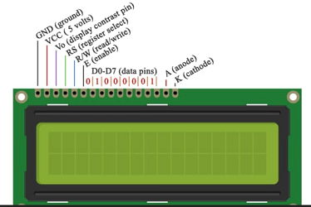
LCD DISPLAY
CONNECTED TO THE DIGITAL SIDE OF THE ARDUINO BOARD

Slide 7
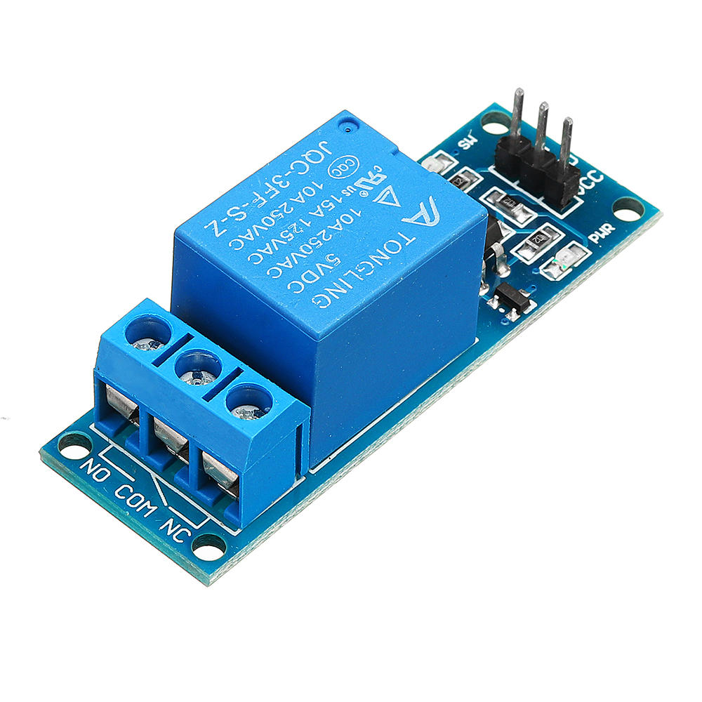
RELAY
IN THIS 3 PINS THE POSITIVE AND NEGATIVE PINS ARE CONNECTED TO THE VIN AND GND OFTHE ARDUINO BOARD AND THE OTHER PIN IS CONNECTED TO PD2 IN DIGITAL SIDE.
THE OUTPUT PINS ARE CONNECTED TO THE MOTOR WHICH ROTATES WHEN RAIN IS DETECTED

